Slide 1

Introduction to Embedded system
Mulam Akhil Teja
1217104080
4H
Notes:
NOTE:
To change the image on this slide, select the picture and delete it. Then click the Pictures icon in the placeholder to insert your own image.

Slide 2
TOPICS TO BE DISCUSSED
Embedded systems exist earlier
System
Embedded System
Components
Classifications
Applications

Slide 3
Were the Embedded Systems Existing Earlier?
Yes, We have been enjoying the brace of Embedded system quite a long time. But they were not so popular because in those days most of the embedded systems were designed around a microprocessor unlike todays systems which were built around a microcontroller.
As we know a microprocessor by itself do not possess any memory, ports etc. So everything must be connected externally by using peripherals like 8255,8257,8259 etc. So the Embedded systems using microprocessor was not only complicated in design but also large in size. At the same time the speed of microprocessor is also a limitation for high end applications.

Slide 4
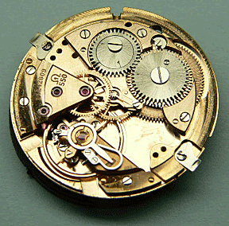
What is System?
A system is a way of working, organizing or doing one or many tasks according to a fixed plan, program or set of rules.
A system is also an arrangement in which all its units assemble and work together according to the plan or program.
Example: WATCH
It is a time display SYSTEM
Parts: Hardware, Needles, Battery, Dial, Chassis and Strap
Rules :
1.All needles move clockwise only
2.A thin needle rotates every second
3.A long needle rotates every minute
4.A short needle rotates every hour
5.All needles return to the original position after 12 hours

Slide 5
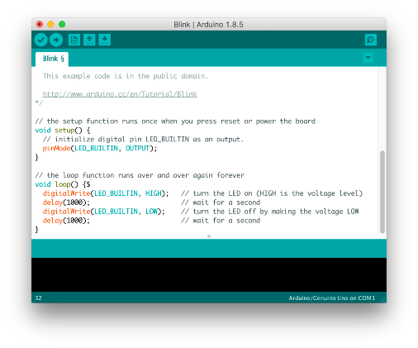
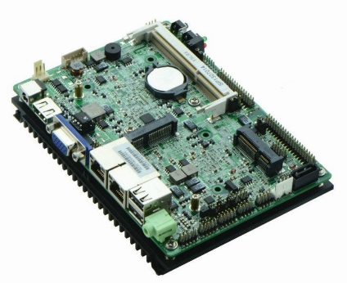
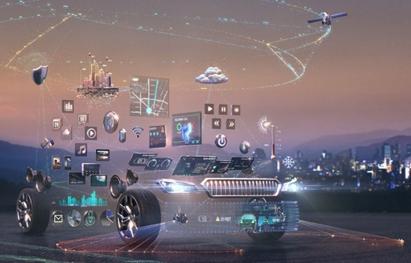
EMBEDDED SYSTEM
Definition: An Embedded System is one that has computer hardware with software embedded in it as one of its important components.
Software
Hardware
Application

Slide 6
COMPONENTS OF EMBEDDED SYSTEM
It has Hardware
Processor, Timers, Interrupt controller, I/O Devices, Memories, Ports, etc.
It has main Application Software
Which may perform concurrently the series of tasks or multiple tasks.
It has Real Time Operating System (RTOS)
RTOS defines the way the system work. Which supervise the application software. It sets the rules during the execution of the application program. A small scale embedded system may not need an RTOS.

Slide 7
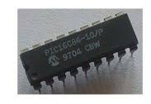
CLASSIFICATIONS OF EMBEDDED SYSTEM
SMALL SCALE EMBEDDED SYSTEM
Single 8 bit or 16bit Microcontroller.
Little hardware and software complexity.
They May even be battery operated.
Usually “C” is used for developing these system.
The need to limit power dissipation when system is running continuously.
Programming tools: Editor, Assembler and Cross Assembler

Slide 8
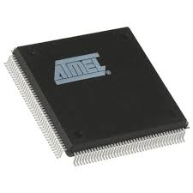
Contd…
MEDIUM SCALE EMBEDDED SYSTEM
Single or few 16 or 32 bit microcontrollers or Digital Signal Processors (DSP) or Reduced Instructions Set Computers (RISC).
Both hardware and software complexity.
Programming tools: RTOS, Source code Engineering Tool, Simulator, Debugger and Integrated Development Environment (IDE).

Slide 9
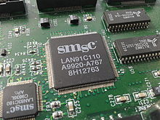
Contd…
SOPHISTICATED EMBEDDED SYSTEM
Enormous hardware and software complexity
Which may need scalable processor or configurable processor and programming logic arrays.
Constrained by the processing speed available in their hardware units.
Programming Tools: For these systems may not be readily available at a reasonable cost or may not be available at all. A compiler or retargetable compiler might have to be developed for this.

Slide 10
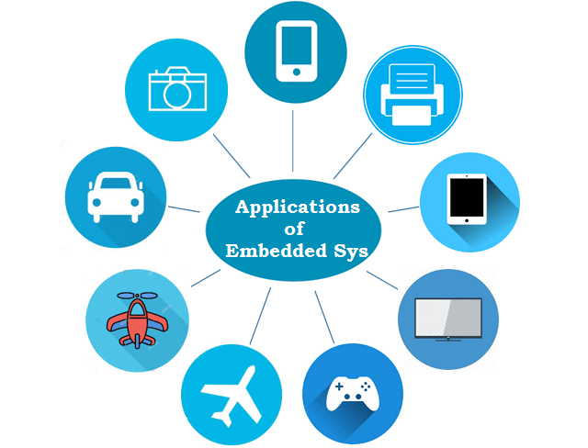
Applications
Tele Communications – Wireless Communications, Mobile Computing
Smart Cards – Banking, Telephone
Automobiles – Engine or Body safety, Car Multimedia
Satellites & Missiles – Defence, Aerospace
Computer Networking – Image Processing, Printers
Digital Consumer Electronics – Digital Camera, Tv’s

Slide 11
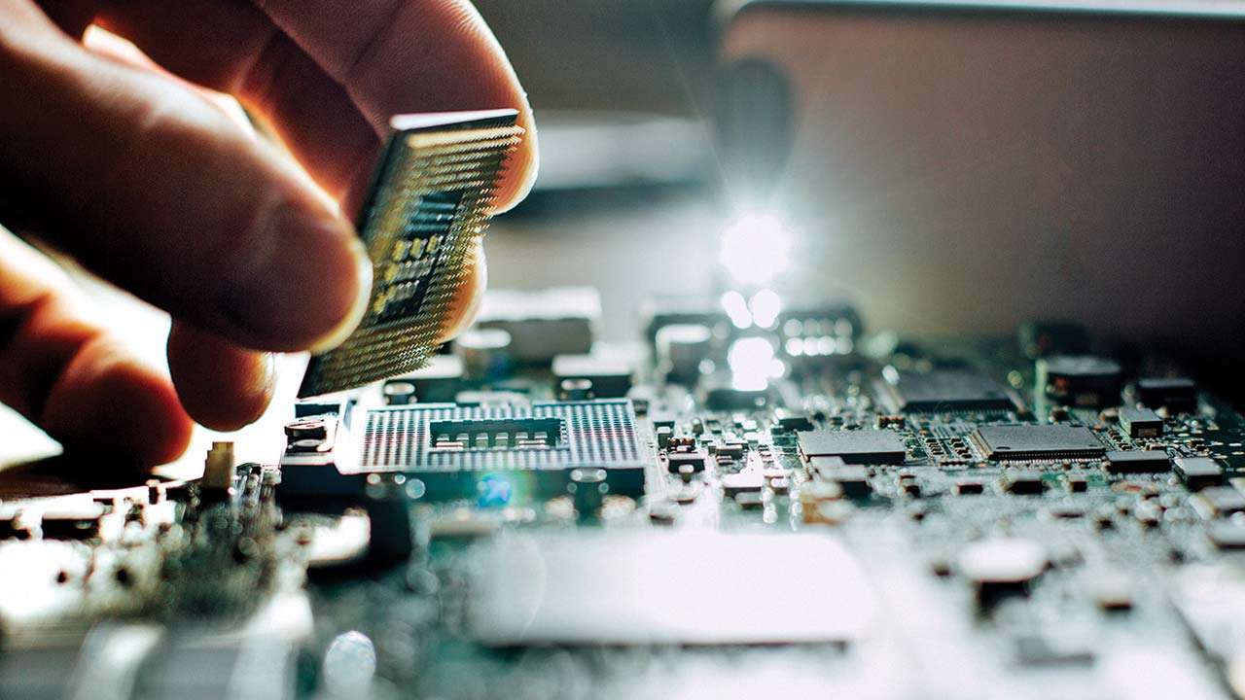
Thank You

